Slide 1
Maven and IO
Lecture #03. Bytes or chars, that is the question

Slide 2
Package
package com.example.app.subsystem.module;
Namespace
Hierarchial
Scope of visibility
Notes:
В Java 9 появились модули. Это — дополнительный уровень видимости и контроля доступа.

Slide 3
Access Modifiers
private
default (package private)
protected
public
private < default < protected < public
void method() {}

Slide 4
Import
import java.lang.String; // implicit
import java.io.File; // one class
import java.util.*; // all package
java.net.URL url; // full class name

Slide 5
Package in compile time
<sources root>
com
example
package
SomeClass.java

Slide 6
Conventions
Package name
  valid identifier 7bits → sevenbits
  lower_case_with_underscore (one word is better)
Class name
  CamelCase
  SomeClass.java contains one public class SomeClass

Slide 7



Java Build Tools
Gradle
Maven
Ant
...

Slide 8

Apache Maven
pom.xml (Project Object Model)
implicit targets
lifecycle
strict project structure
plugins
dependencies
dependency repositories

Slide 9
Install Maven
sudo apt-get install maven

Slide 10
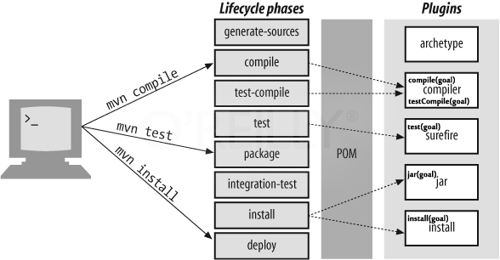
Project lifecycle

Slide 11
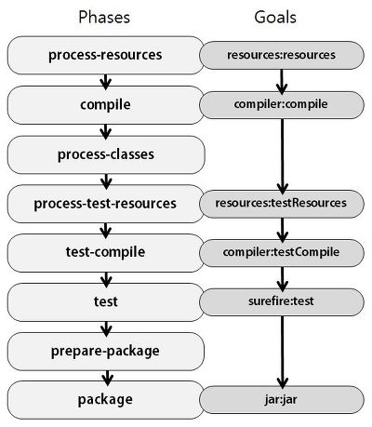
Plugins

Slide 12
Maven most frequent commands
mvn clean — remove target
mvn test — run tests
mvn package — build jar (or war)
mvn install — install lib to local repository
mvn deploy — upload lib to remote repository

Slide 13
pom.xml
<?xml version="1.0" encoding="UTF-8"?>
<project xmlns="http://maven.apache.org/POM/4.0.0"
xmlns:xsi="http://www.w3.org/2001/XMLSchema-instance"
xsi:schemaLocation="http://maven.apache.org/POM/4.0.0 http://maven.apache.org/xsd/maven-4.0.0.xsd">
<modelVersion>4.0.0</modelVersion>
...
</project>

Slide 14
Artifact
<groupId>com.example.app</groupId>
<artifactId>subsystem-module</artifactId>
<version>1.0-SNAPSHOT</version>
Notes:
sybsystem-module — это лишь пример наименования. Обычно артефакты так именуют.

Slide 15
Maven project structure
${project.basedir}
pom.xml
src
main
java
package
*.java
resources
test

Slide 16
Maven target structure
${project.basedir}
pom.xml
target
subsystem-module-1.0-SNAPSHOT.jar
classes
package
*.class

Slide 17
Dependencies
<dependencies>
<dependency>
<groupId>junit</groupId>
<artifactId>junit</artifactId>
<version>4.12</version>
<scope>test</scope>
</dependency>
</dependencies>

Slide 18
Repositories
~/.m2/repository
The Central Repository: http://search.maven.org/

Slide 19
JavaDoc — developer's best friend
http://docs.oracle.com/javase/8/docs/api/
java.io
java.nio

Slide 20
java.io.File
Path to file on disk
File dir = new File("."); // current dir
File file = new File(dir, "test.txt"); // file in dir
File.separator; // path separator (/ or \)
file.getAbsoluteFile(); // absolute path (as File)
file.getAbsolutePath(); // absolute path (as String)
file.getParent(); // parent path (as String)
file.getPath(); // path to file
file.listFiles(); // list of files in dir

Slide 21
java.io.File
Metadata and manipulations
file.exists(); // check existence
file.canRead(); // check ability to read
file.isDirectory(); // is it dir?
file.lastModified(); // last modified time
file.length(); // size
file.createNewFile(); // create empty file
file.delete(); // delete file
file.setReadable(true); // allow to read

Slide 22
Symbol, code, byte
String str = "Кириллица";
byte[] bytes = str.getBytes();
// -48, -102, -48, -72, -47, -128, -48, -72, -48, -69, -48, -69, -48, -72, -47, -122, -48, -80
char[] chars = str.toCharArray(); // К, и, р, и, л, л, и, ц, а
str.codePointAt(0); // 1050

Slide 23
java.io.InputStream
Stream of bytes to read
InputStream in;
in.read(); // read a byte
byte[] bytes = new byte[16];
in.read(bytes); // read to buffer
in.skip(10); // skip 10 bytes
in.close(); // close the stream

Slide 24
InputStream wrapping
Streams wrap each other to add new features
InputStream fileStream =
new FileInputStream(new File("test.txt"));
InputStream bufferedStream =
new BufferedInputStream(fileStream);
bufferedStream.read(); // buffered read

Slide 25
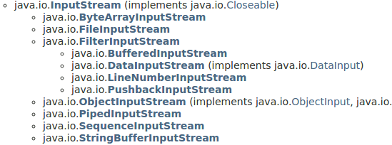
InputStreams

Slide 26
java.io.OutputStream
Stream of bytes to write
OutputStream out;
out.write('a'); // write a byte
byte[] bytes = { 'a', 'b', 'c' };
out.write(bytes); // write buffer
out.flush(); // flush data to disk
out.close(); // close the stream

Slide 27
OutputStream wrapping
Streams wrap each other to add new features
OutputStream fileStream =
new FileOutputStream(new File("test.txt"));
PrintStream printStream =
new PrintStream(fileStream);
printStream.println("hello");

Slide 28
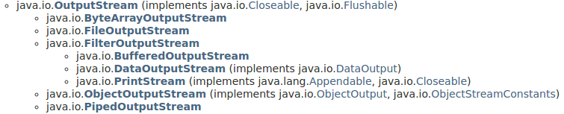
OutputStreams

Slide 29
java.io.Reader
Stream of characters to read
Reader reader;
reader.read(); // read character
char[] chars = new char[16];
reader.read(chars); // read to buffer
reader.skip(10); // skip 10 chars
reader.close(); // close the stream

Slide 30
Reader wrapping
Streams wrap each other to add new features
Reader wraps InputStream, adding encoding
InputStream fileStream =
new FileInputStream(new File("test.txt"));
Reader fileReader =
new InputStreamReader(fileStream, "utf-8");
BufferedReader reader =
new BufferedReader(fileReader);
reader.readLine(); // read text line(String)

Slide 31
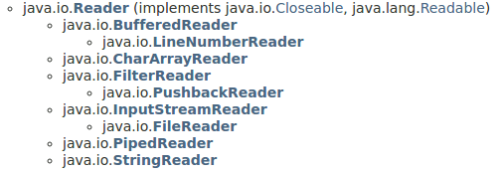
Readers

Slide 32
java.io.Writer
Stream of characters to write
Writer writer;
writer.write('a'); // write character
char[] chars = { 'a', 'b', 'c'};
writer.write(chars); // write buffer
writer.write("abc"); // write string
writer.flush(); // flush data to disk
writer.close(); // close the stream

Slide 33
Writer wrapping
Streams wrap each other to add new features
Writer wraps OutputStream, adding encoding
OutputStream fileStream =
new FileOutputStream(new File("test.txt"));
Writer fileWriter =
new OutputStreamWriter(fileStream, "utf-8");
PrintWriter printWriter =
new PrintWriter(fileWriter);
printWriter.println("hello");

Slide 34
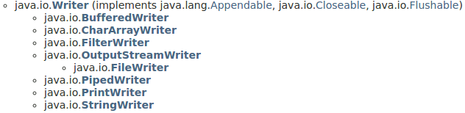
Writers

Slide 35
java.nio.file.FileSystem
FileSystem fs = FileSystems.getDefault();
String separator = fs.getSeparator();
FileSystemProvider provider = fs.provider();

Slide 36
java.nio.file.Path
Path path = fs.getPath("dir", "file.txt");
Path fileName = path.getFileName();
Path firstDir = path.getName(0);
Path parent = path.getParent();
Path root = path.getRoot();

Slide 37
java.nio.file.Files
boolean readable = Files.isReadable(path);
long size = Files.size(path);
InputStream in = Files.newInputStream(path);
OutputStream out = Files.newOutputStream(path);
Reader reader = Files.newBufferedReader(
path, StandardCharsets.UTF_8);
Writer writer = Files.newBufferedWriter(
path, StandardCharsets.UTF_8);

Slide 38
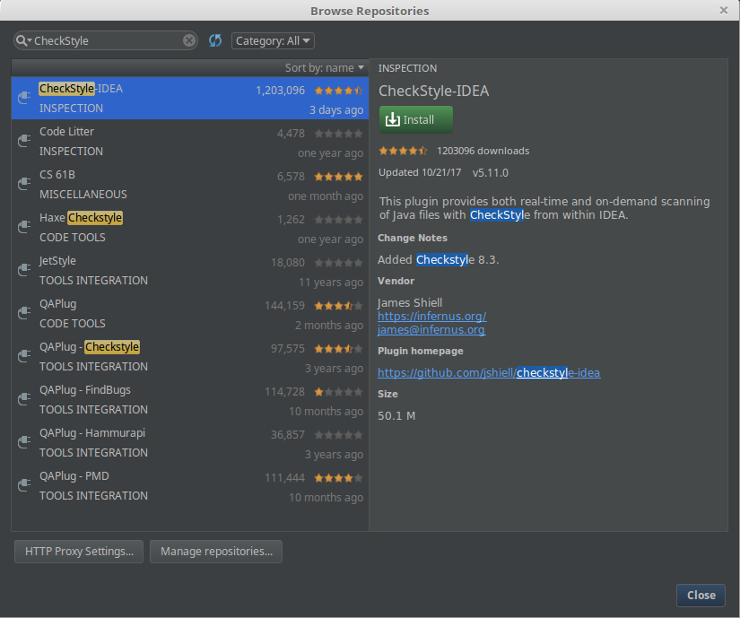
CheckStyle install
File > Settings > Plugins > Browse repositories

Slide 39
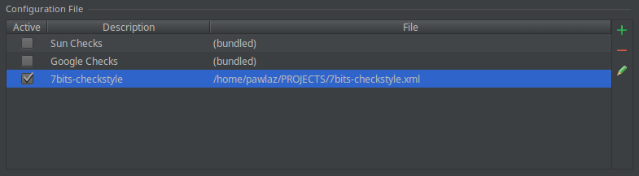
7bits-CheckStyle install
File > Settings > Other Settings > CheckStyle

Slide 40

Checkstyle + IDEA

Slide 41
Conventions
Сurly brace opens on the same line
Block is indented with four spaces
for, if-else always used with blocks
Method name is camelCase but starts from lower case letter
Parameter names are camelCase
...

Slide 42
JavaDoc
Java Documentation
Embed to source code

Slide 43
Package documentation
package-info.java
/**
* Package containing HelloWorld.
*/
package it.sevenbits.example.helloworld;

Slide 44
Class documentation
package it.sevenbits.example.helloworld;
/**
* Simplest HelloWorld implementation
*/
public final class HelloWorld {

Slide 45
Method documentation
/**
* Entry method
* @param args command line args, ignored
*/
public static void main(final String[] args) {
System.out.println("Hello, world!");
}

Slide 46
Generate documentation
mvn javadoc:javadoc
target
site
apidocs
index.html
...

Slide 47
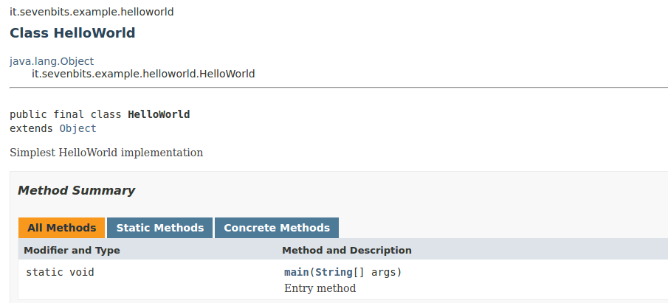
Web documentation

Slide 48
Homework
Install maven
Create maven project
Add CheckStyle
Create first formatter
Road to formatter begins here :)
7bits-checkstyle

Slide 49
Questions & Homework
To: denis.nelubin@7bits.it
Cc: teachers@7bits.it

